Slide 1
Antiquity of Southeastern Europe Research Centre, University of Warsaw
Krzysztof Narloch

Slide 2
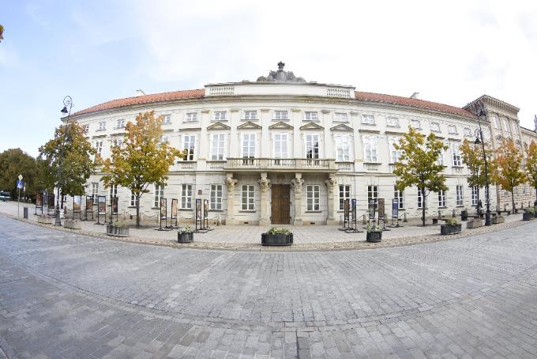
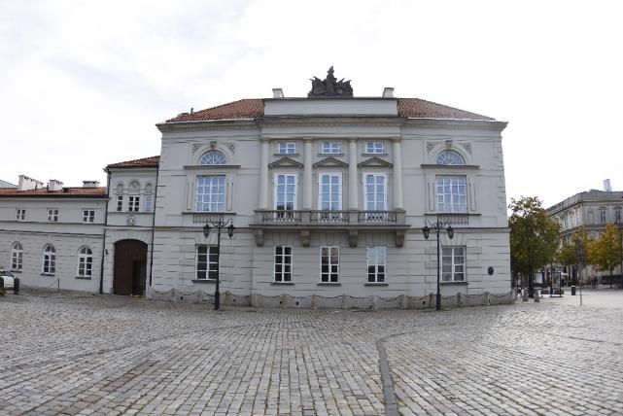
Antiquity of Southeastern Europe Research Centre

Slide 3
Main Research activities

Slide 4
Risan, Montenegro

Slide 5
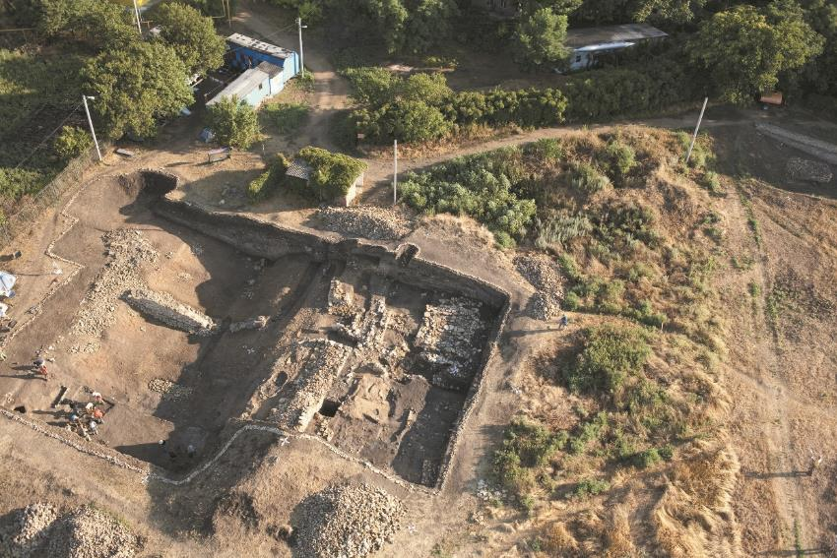
Scodra, Bushati, Albania

Slide 6
NOVAE, Bulgaria

Slide 7
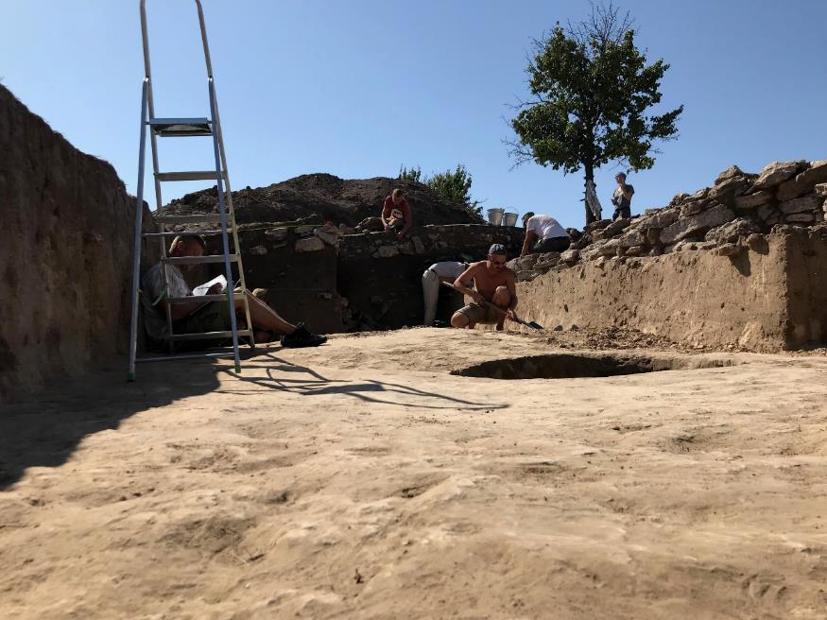
Konsulovskoe, Ukraine

Slide 8
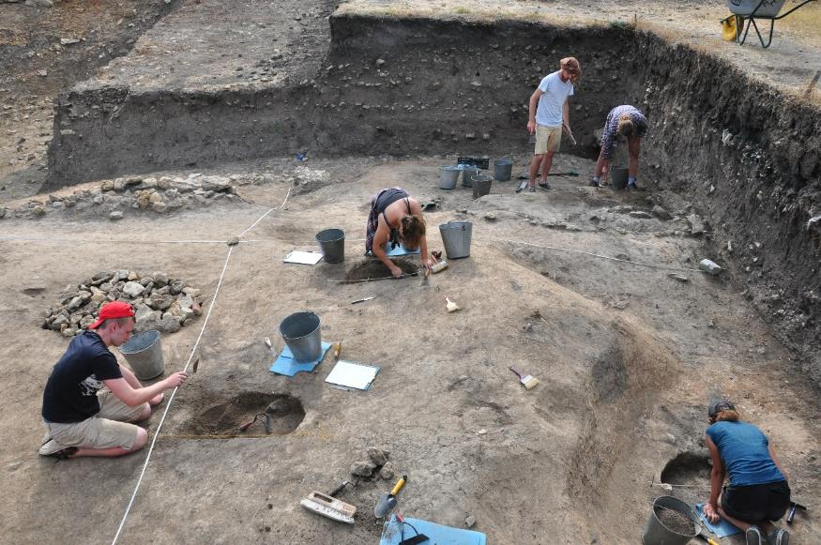
Tanais, Russia

Slide 10
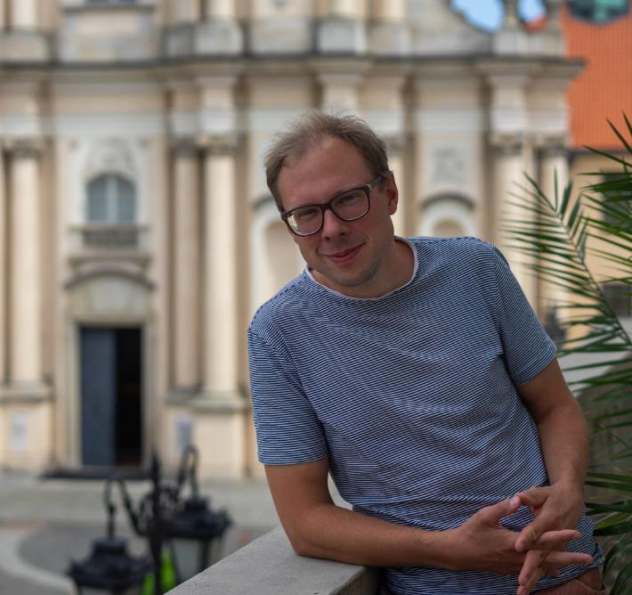
Our team
Aleksandra Miernik
aa.miernik@uw.edu.pl
Bartosz Wojciechowski
bw.wojciechows@uw.edu.pl

Slide 11
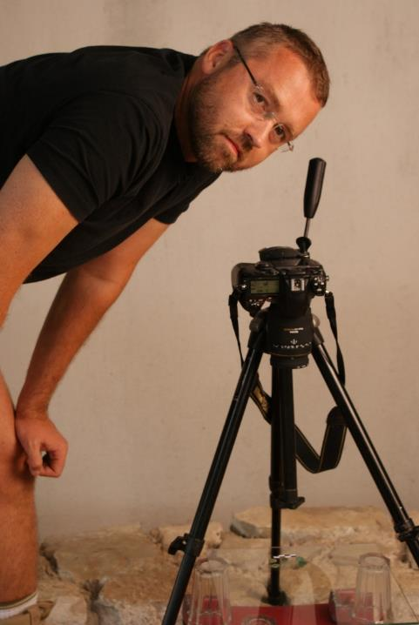
Martin Lemke
m.lemke@uw.edu.pl
Janusz Recław
j.reclaw@uw.edu.pl

Slide 12
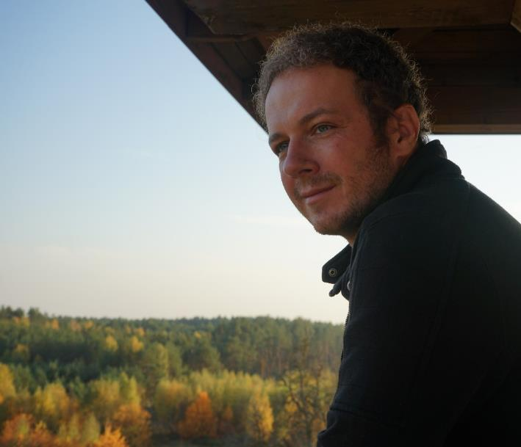
Piotr Dyczek
novae@uw.edu.pl
Krzysztof Narloch
k.narloch@uw.edu.pl

Slide 13
Thank You for your attention

