Slide 1



Antiquity of Southeastern Europe
Research Centre,
University of Warsaw
Krzysztof Narloch

Slide 2
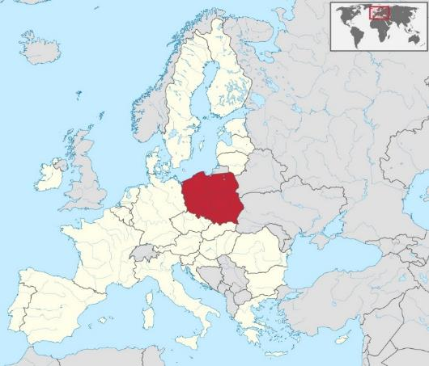
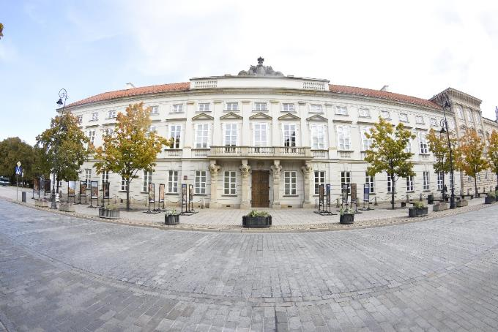
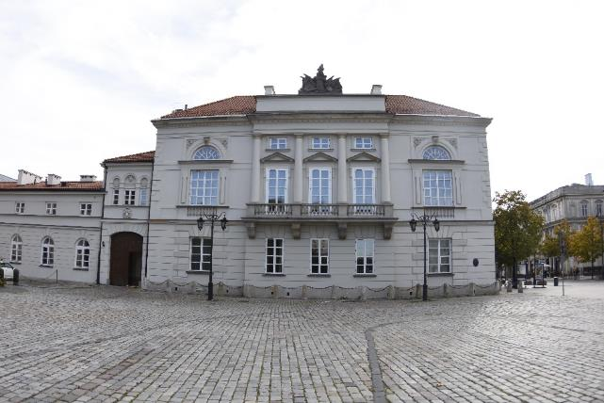
Antiquity of Southeastern Europe Research Centre

Slide 3
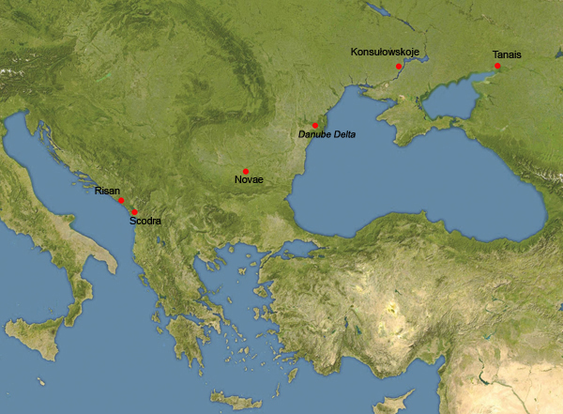
Main Research activities

Slide 4
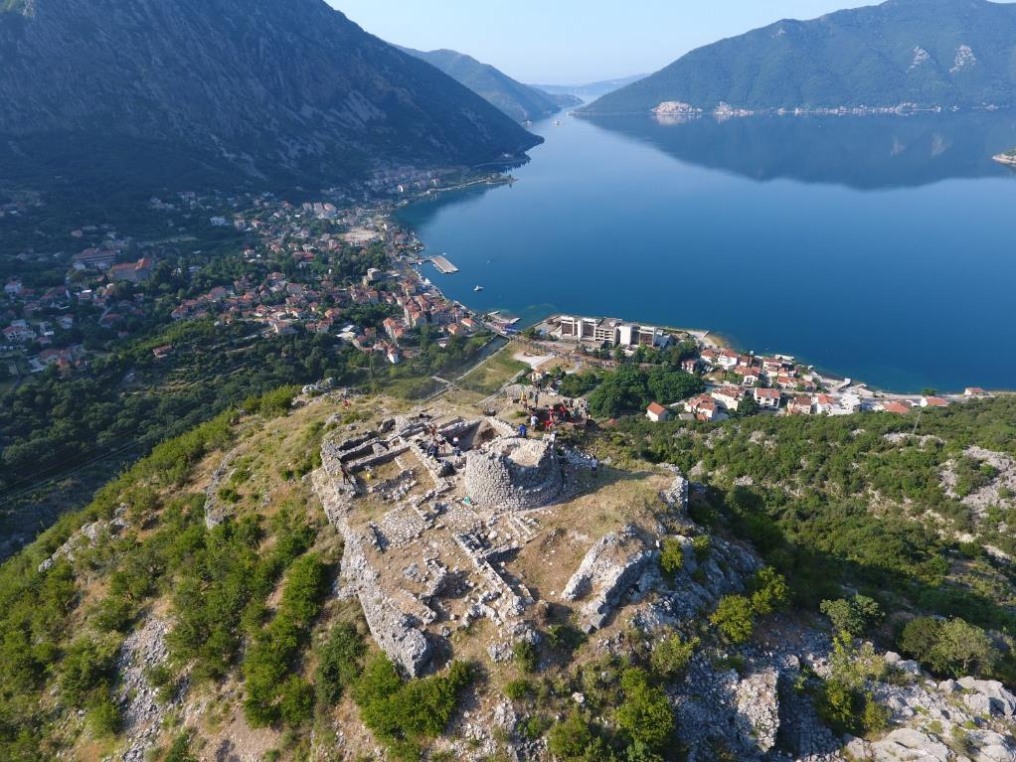
Risan, Montenegro

Slide 5
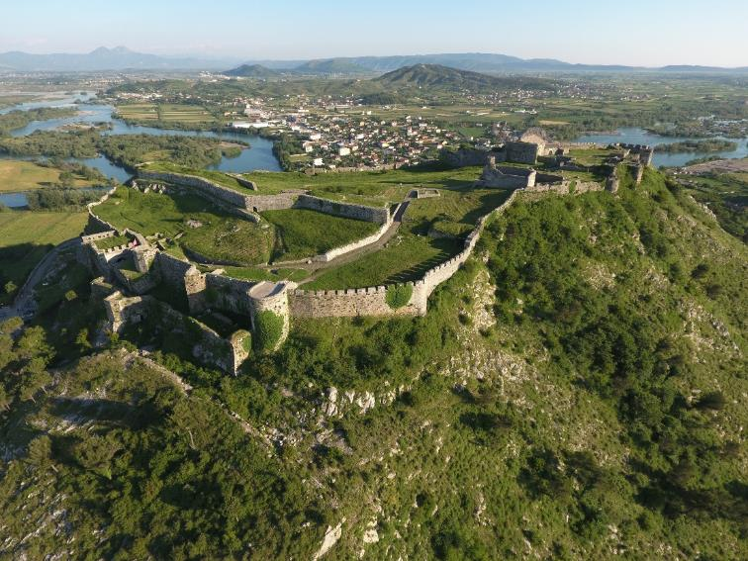
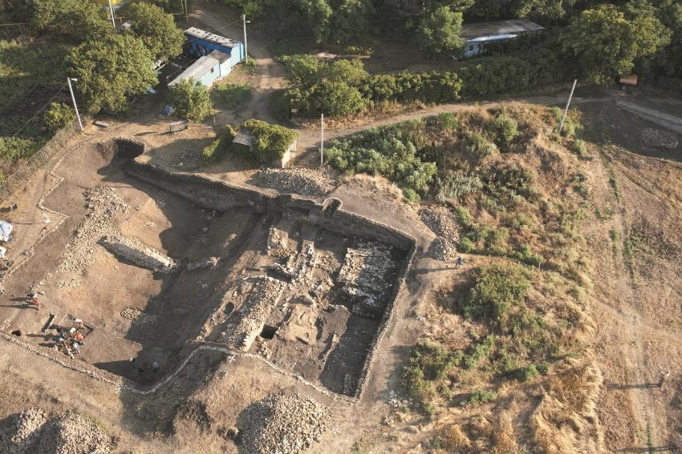
Scodra, Bushati, Albania

Slide 6
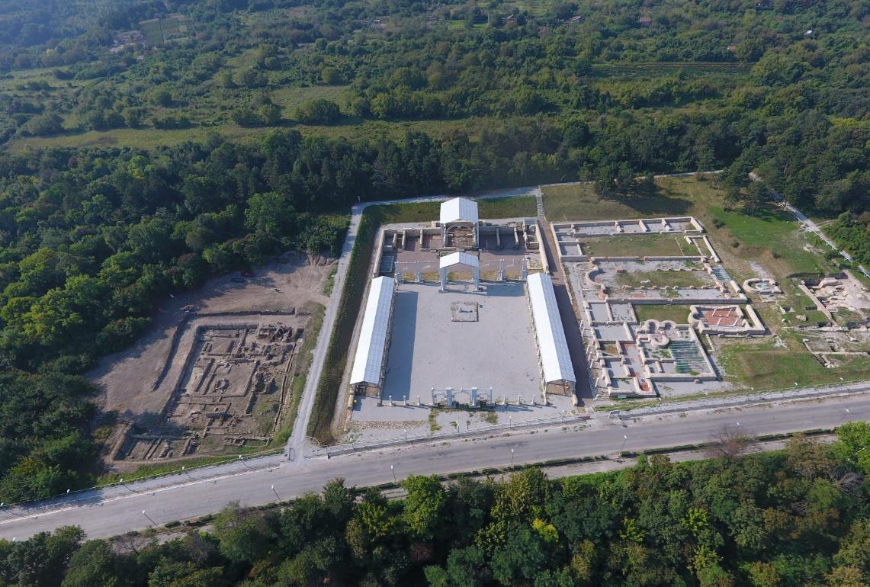
NOVAE, Bulgaria

Slide 7
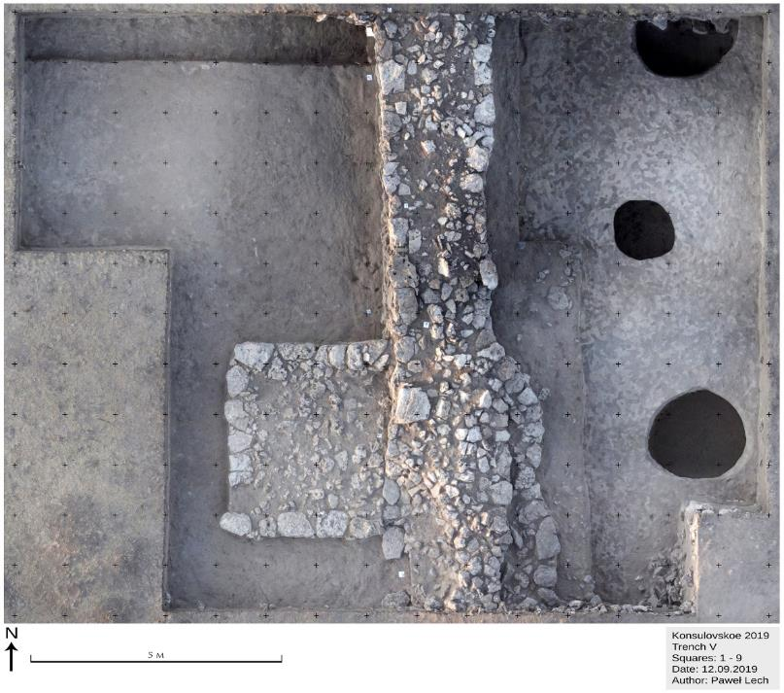
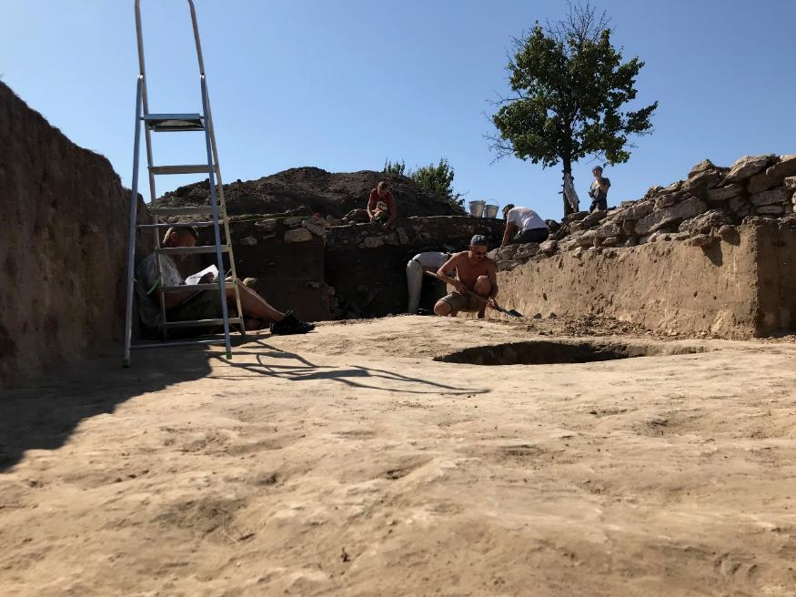
Konsulovskoe, Ukraine

Slide 8
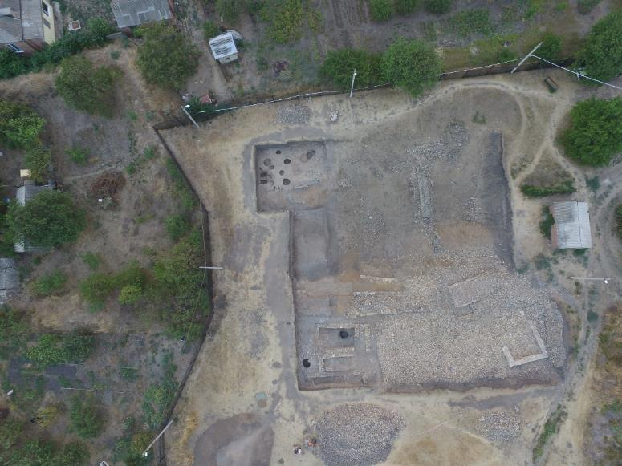
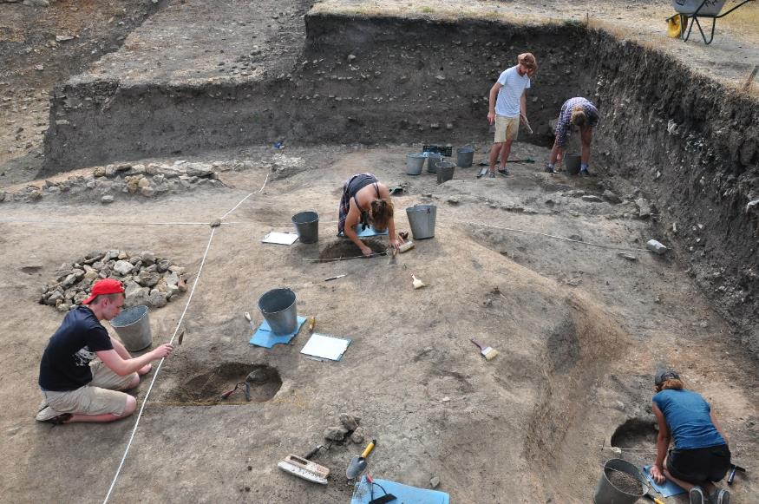
Tanais, Russia

Slide 9
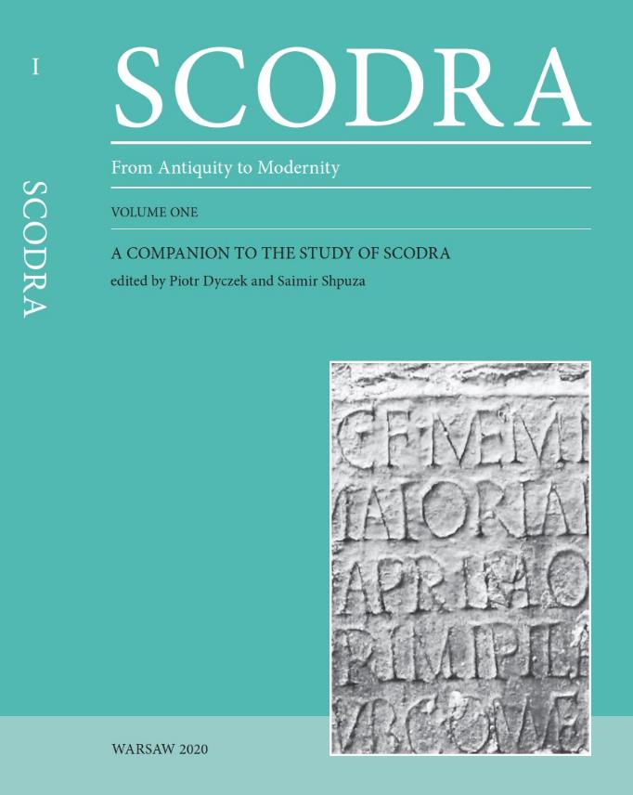





Slide 10
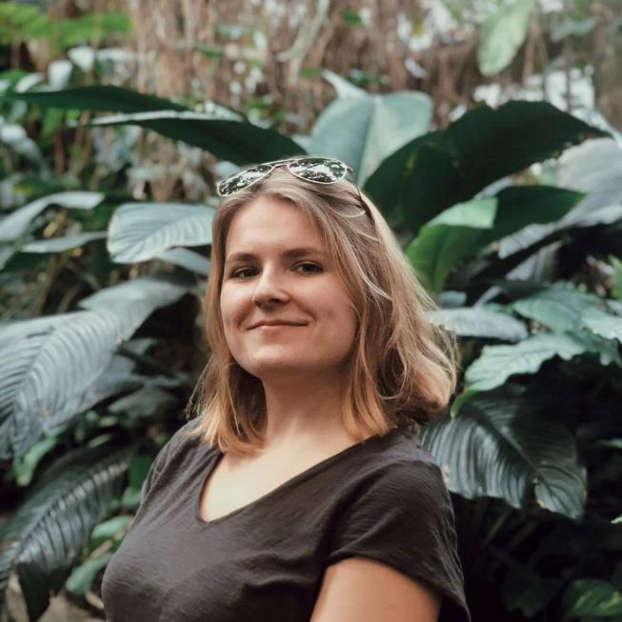
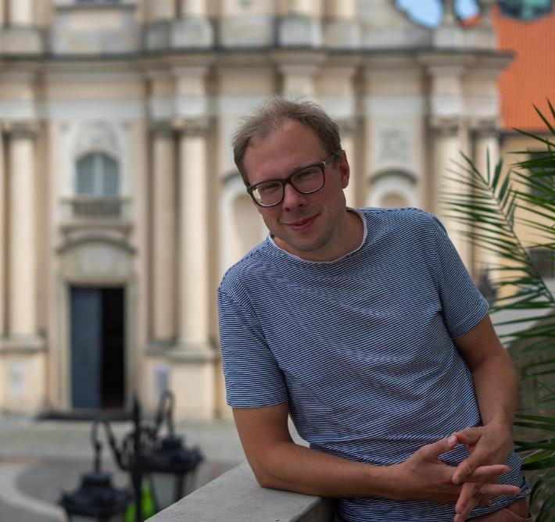
Our team
Aleksandra Miernik
aa.miernik@uw.edu.pl
Bartosz Wojciechowski
bw.wojciechows@uw.edu.pl

Slide 11
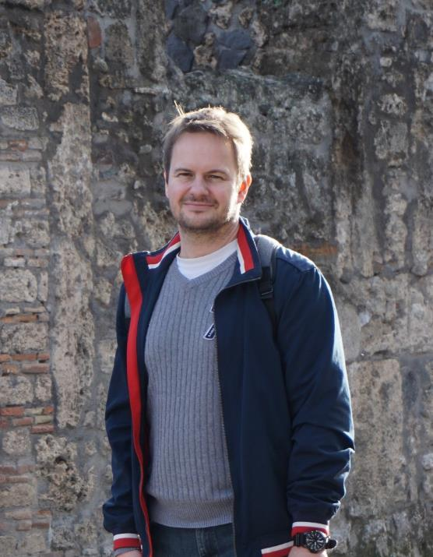
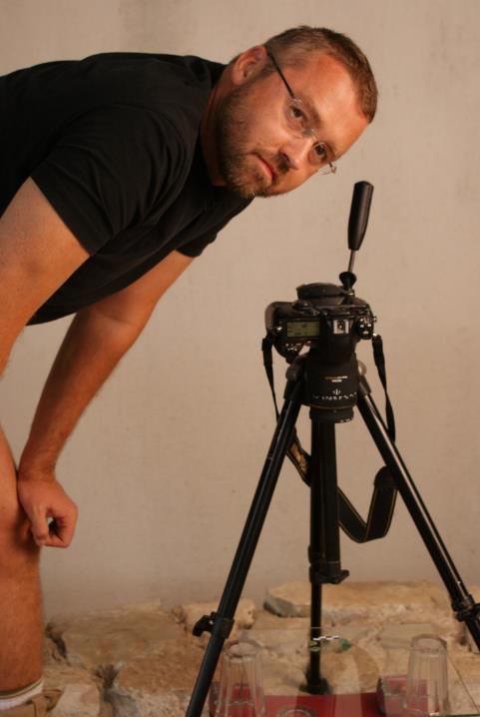
Martin Lemke
m.lemke@uw.edu.pl
Janusz Recław
j.reclaw@uw.edu.pl

Slide 12
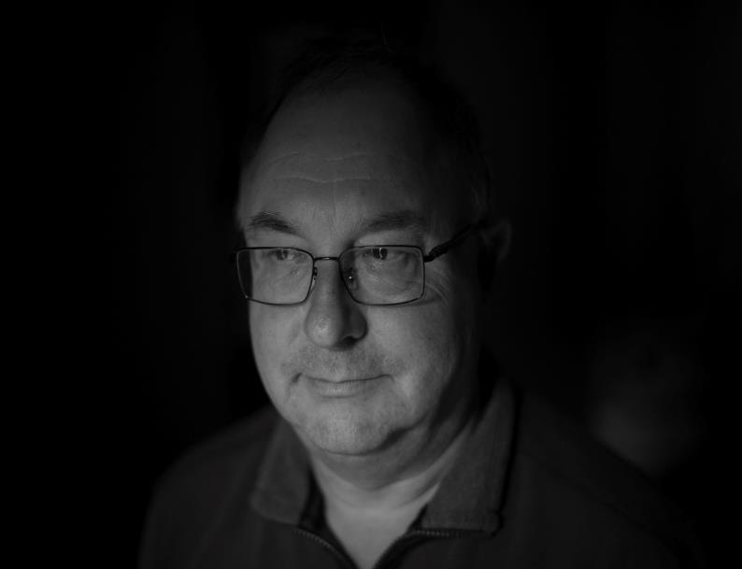
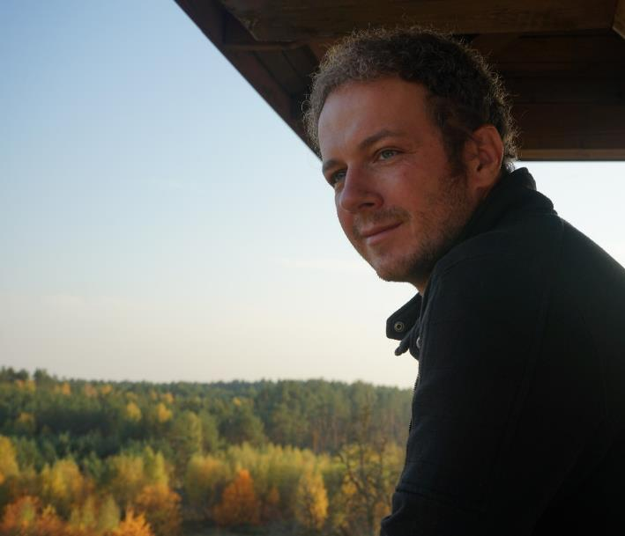
Piotr Dyczek
novae@uw.edu.pl
Krzysztof Narloch
k.narloch@uw.edu.pl

Slide 13
Thank You for your attention

